Slide 1
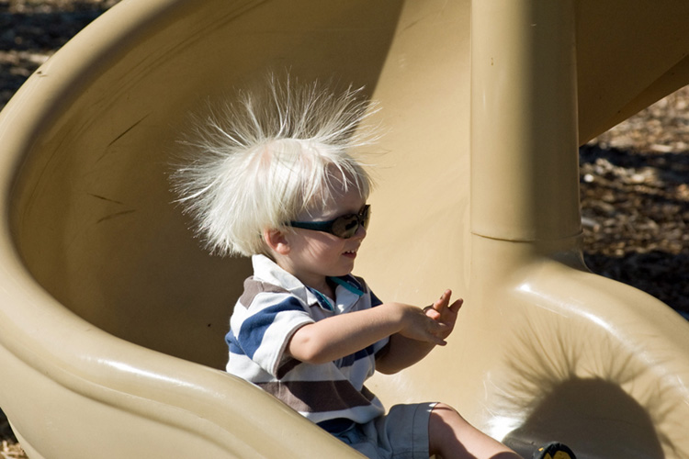
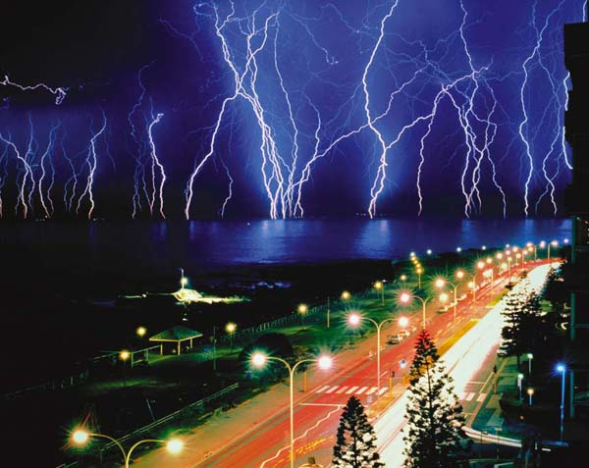
Chapter-18 Electric Charge, Forces and Electric Fields

Slide 2
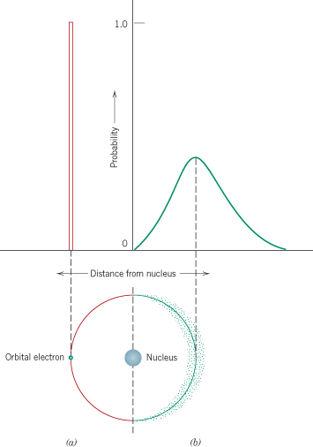
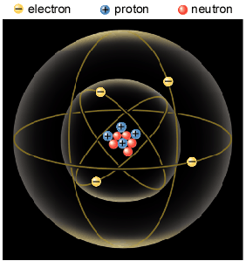
Electric Charge
Atomic Model
The coulomb unit is derived from the SI unit ampere for electric current i. Current is the rate at which charge moves through a region.
Atomic Particle
Charge
Mass
Electron
–1.6 × 10⁻¹⁹ C
9.11 × 10⁻³¹ Kg
Proton
+1.6 × 10⁻¹⁹ C
1.673 × 10⁻²⁷ Kg
Neutron
0
1.675 × 10⁻²⁷ Kg

Slide 3
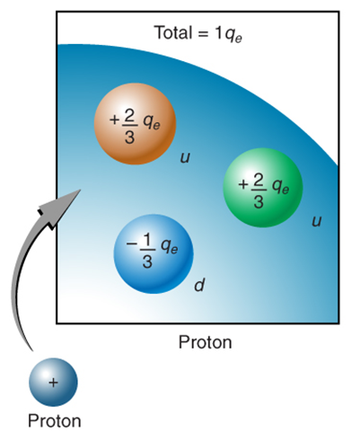
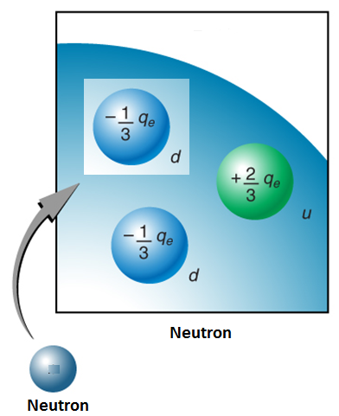
Substructure of Proton and Neutron
Proton: 2 up quarks and 1 down quark
Neutron: 1 up quark and 2 down quarks

Slide 4
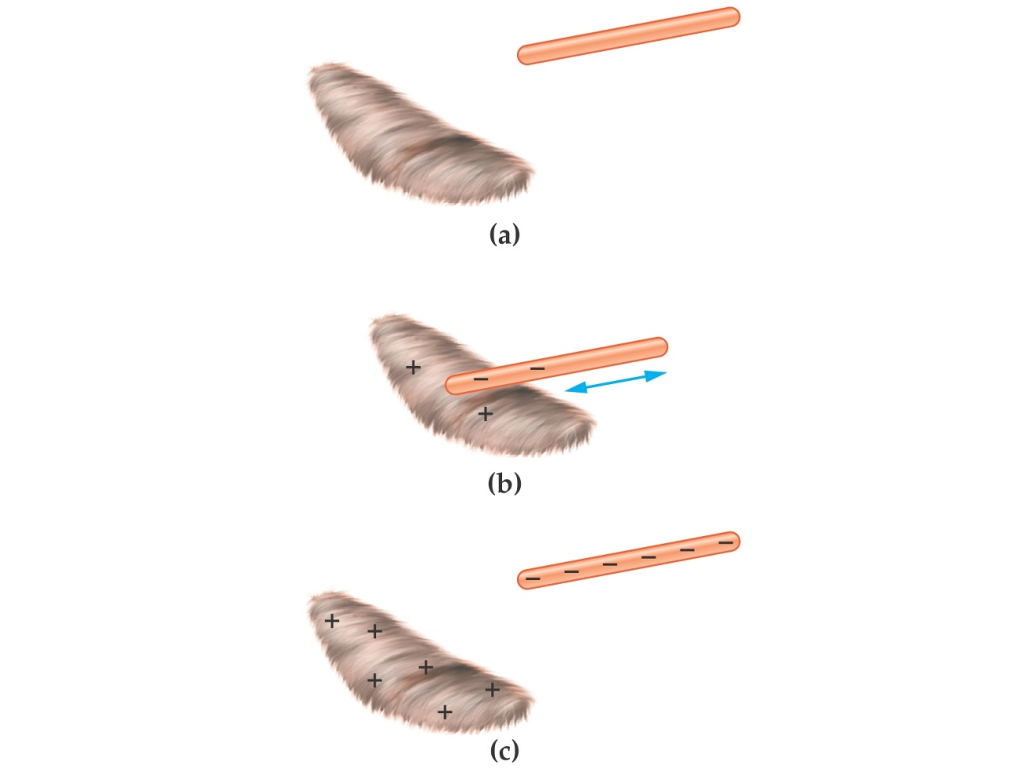
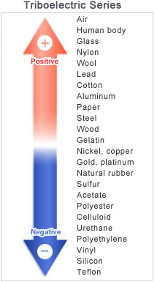
Charging Ebonite Rod & Fur

Slide 5
Charging an Object
Ebonite rod & Fur → Negatively charged ebonite rod
Glass rod & Silk → Positively charged glass rod
Note that only conduction electrons, with their negative charges, can move; positive ions are fixed in place.
Thus, an object becomes positively charged only through the removal of electrons.

Slide 6
LAW OF CONSERVATION OF ELECTRIC CHARGE
During any process, the net electric charge of an isolated system remains constant (is conserved).
This hypothesis of conservation of charge, first put forward by Benjamin Franklin, has stood up under close examination, both for large-scale charged bodies and for atoms, nuclei, and elementary particles.
No exceptions have ever been found.
The list of quantities that obey a conservation law: Energy, Linear momentum, angular momentum, and electric charge.

Slide 7
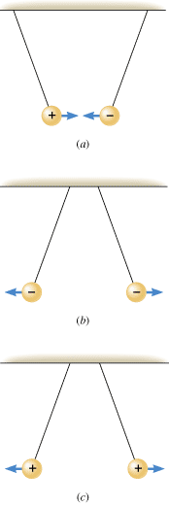
Like charges repel and unlike charges attract each other.

Slide 8
Conductors and Insulators
Substances that readily conduct electric charge are called electrical conductors. Conductors have free electrons, which conduct the electricity. Examples: Metals such as copper, aluminum, silver, gold, and tap water.
When atoms of a conductor like copper come together to form the solid, some of their outermost (and so most loosely held) electrons become free to wander about within the solid, leaving behind positively charged atoms (positive ions).
We call the mobile electrons conduction or free electrons. There are few (if any) free electrons in a nonconductor (insulator).
Materials that conduct electric charge poorly are known as electrical insulators. Examples: Rubber, plastics, dry-wood, and chemically pure water.
Semiconductors are materials that are intermediate between conductors and insulators; examples include silicon and germanium in computer chips.
Superconductors are materials that are perfect conductors, allowing charge to move without any hindrance.

Slide 9
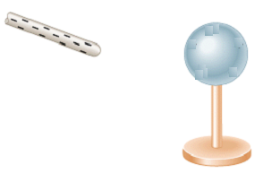
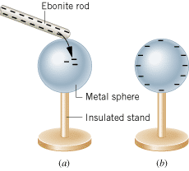
Charging an object
An object can be charged by two methods:
-By contact.
-By induction.
Charging By Contact:

Slide 10
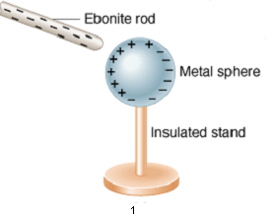
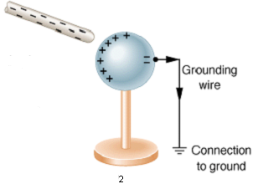
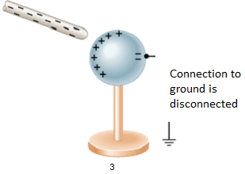
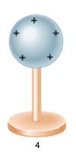
Charging By Induction

Slide 11
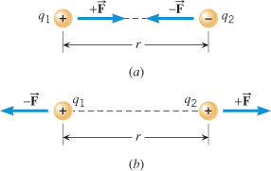
Coulomb's Law
Two charged particles attract each other if they have the opposite sign of charge, and repel each other if they have the same signs of charge.
This force of repulsion or attraction due to the charge properties of objects is called an electrostatic force.
The equation giving the force for charged particles is called Coulomb's law after Charles-Augustin de Coulomb.
k = Coulomb’s constant ε₀ = permittivity of free space

Slide 12
Three Charges on a line
16. A test charge of +2 μC is placed halfway between a charge of +6 μC and another of +4 μC separated by 10 cm. (a) What is the magnitude of the force on the test charge? (b) What is the direction of this force (away from or toward the +6 μC charge)?

Slide 13
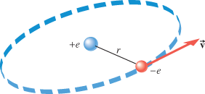
Bohr Model
In the Bohr model of the hydrogen atom, the electron is in a circular orbit about the nuclear proton at a radius of as Figure 18.10 shows. The mass of the electron is . Determine the speed of the electron.

